Slide 1
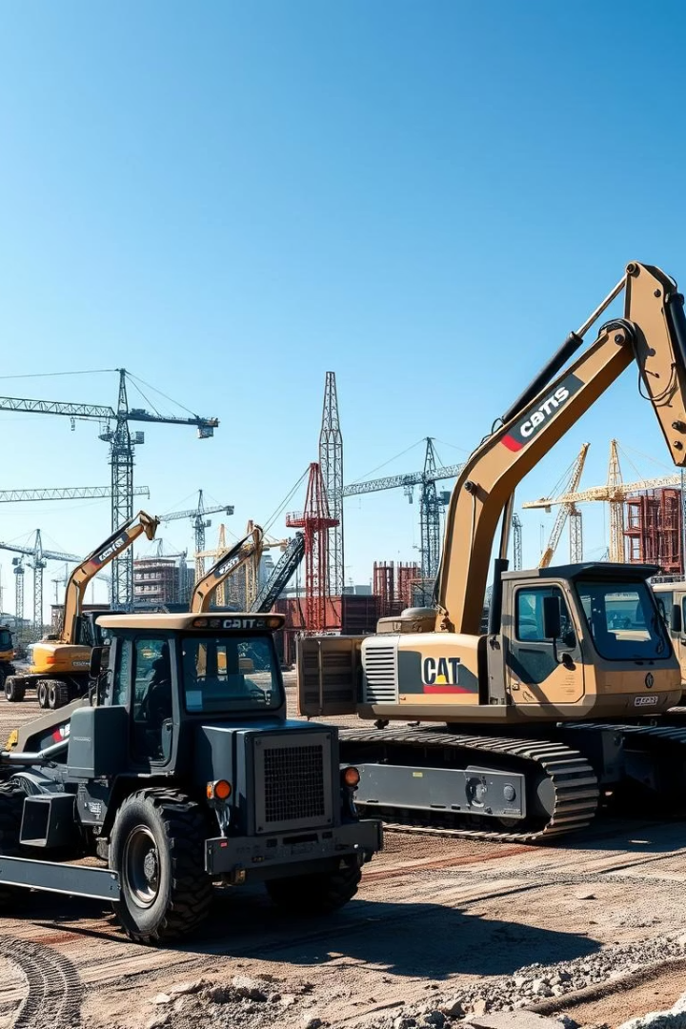

Construction Equipment: An Overview
Explore essential construction machinery shaping modern building projects.

Slide 2
Excavators: Digging Deep
Key Functions
Components
Excavators scoop, dig, and move heavy soil efficiently.
Hydraulic arm for powerful digging
Rotating cab for flexible operation
Tracked base for rough terrain

Slide 3
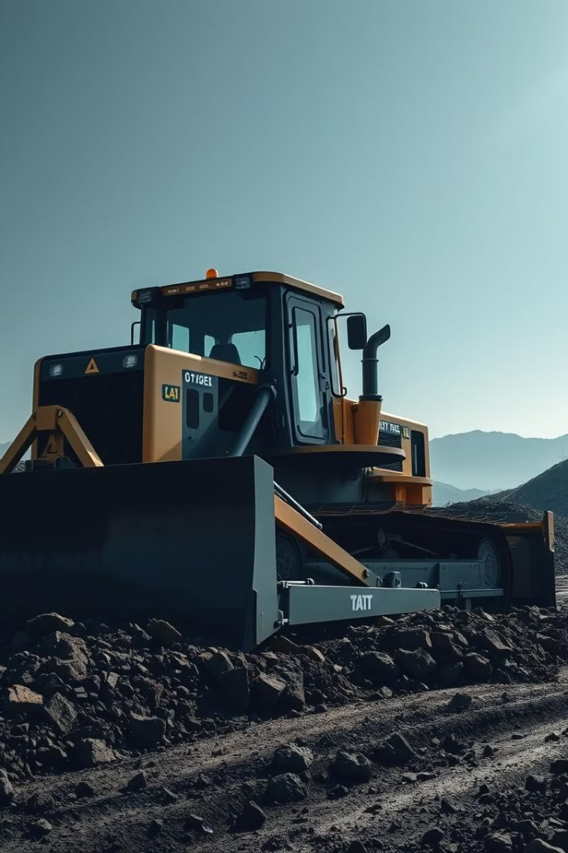
Bulldozers: Pushing Boundaries
Primary Use
Design Features
Clearing, grading, and pushing earth and debris.
Strong blade mounted on tracked chassis for stability.
Advantages
Outstanding power and precision in tough conditions.

Slide 4
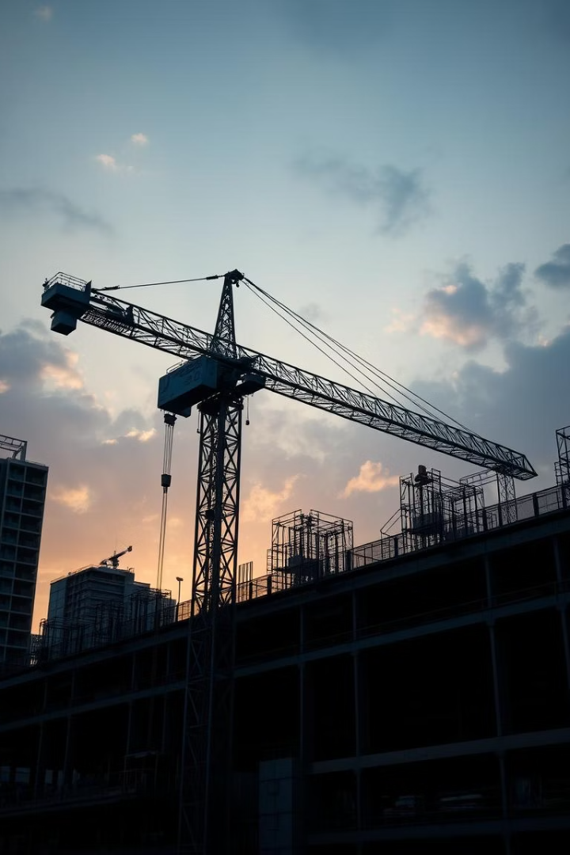
Cranes: Reaching New Heights
Types
Uses
Tower cranes for tall buildings
Essential for heavy lifting and precise placement at heights.
Mobile cranes for flexible movements
Safety
Advanced controls and monitoring ensure secure operations.

Slide 5
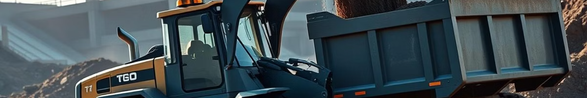



Loaders: Moving Mountains
Wheel Loaders
Versatile machines for loading and transport tasks.
Skid Steers
Compact and agile for confined spaces.
Features
Powerful buckets
Four-wheel drive

Slide 6



Dump Trucks: Hauling Heavy Loads
Transporting
2
Trucks move heavy loads across rough terrain to dump sites.
Loading
1
Material loaded efficiently by loaders or excavators.
Unloading
Dumping loaded material for further processing or disposal.
3

Slide 7
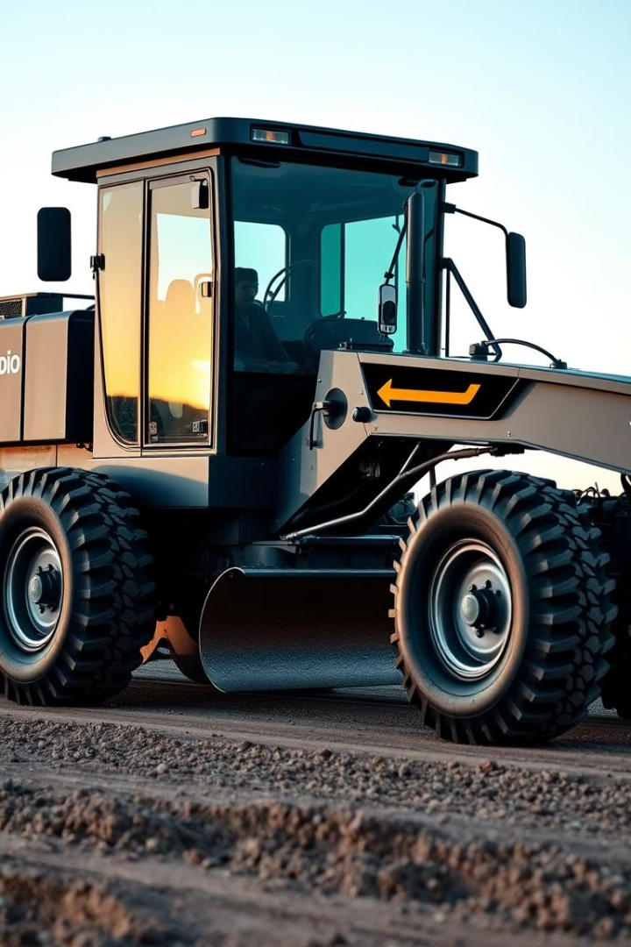
Graders: Smoothing the Way
Set Blade Angle
Position blade for precise soil shaping.
Level Surface
Achieve uniform grading for roads and foundations.
Compact Material
Ensure surface readiness before paving or construction.

Slide 8

Rollers: Compacting for Strength
10
50
Types of Rollers
Operating Weight (tons)
Including smooth drum, pneumatic, and tandem rollers.
Depends on roller size and compaction needs.
33%
Compaction Efficiency
Improves surface strength by reducing air gaps.

Slide 9




Pavers: Laying the Foundation
Material Feeding
Hot mix asphalt delivered into hopper.
Even Spreading
Augers distribute mix evenly across road width.
Smoothing
Screed flattens and compacts for smooth surface.

Slide 10
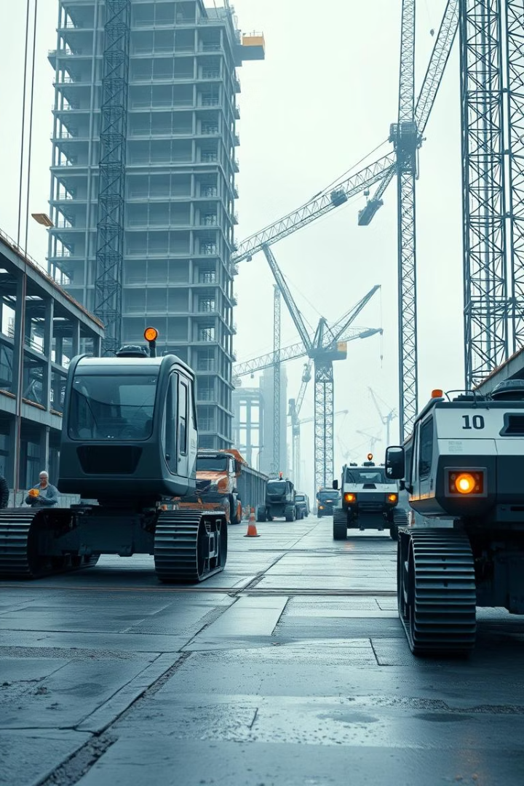
The Future of Construction Equipment: Innovation in Action
1
Automation
Robotic machines increase efficiency and safety.
2
Electric Power
Reducing emissions with clean energy technology.
3
Smart Sensors
Precision monitoring optimizes equipment performance.
4
Data Integration
Real-time data guides project management decisions.

